Slide 1
Client Components
Overview of client components
Special files
Client component routing techniques

Slide 2
Section 1: Overview of Client Components
Recap of Next.js rendering strategies
How to define a client component
Demo application
Handling browser events
Using React hooks
Using browser APIs

Slide 3
Recap of Next.js Rendering Strategies
By default, Next.js renders components at the server
For direct access to server-side resources
For Search Engine Optimization (SEO)
For caching and faster initial page load time
Or, you can tell Next.js to render a component at the client
To handle browser events
To use React hooks
To use browser APIs (e.g., geolocation, web workers, etc.)

Slide 4
How to Define a Client Component
This is how you define a client component:
When the user navigates to the component in a browser:
The component code is downloaded to the client
At the client, the code is processed to generate a virtual DOM
The virtual DOM is rendered as HTML at the browser
'use client'
export default function SomeClientComponent() {
return <> … … … </>
}

Slide 5
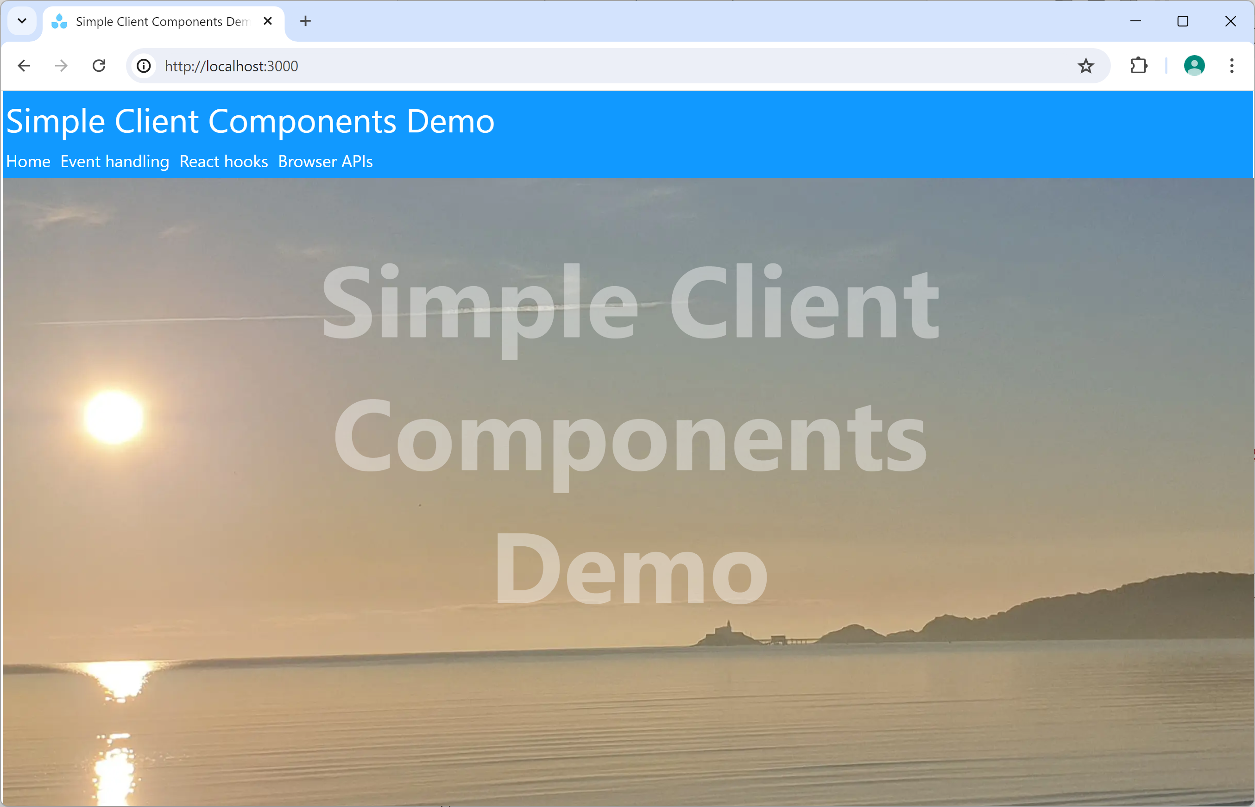
Demo Application
Let's see a demo of how/why to define client components
See the demo app demo-simple-client-components
Prepare and run as follows:
npm install
npm run dev

Slide 6
Handling Browser Events
A client component can handle browser events:
'use client'
…
export default function EventHandling() {
function displayMessage(message: string) {
const messageArea = document.getElementById("messageArea")
messageArea!.innerText = message
}
return (
<div>
<h1>Event handling demo</h1>
<button onClick={() => displayMessage("Hello")}>Say hello</button>
<button onClick={() => displayMessage("Goodbye")}>Say goodbye</button>
<div id="messageArea" className={styles.panel}/>
</div>
);
}
/app/event-handling/page.tsx

Slide 7
Using React Hooks
A client component can use React hooks:
'use client'
import { useState, useEffect } from 'react'
…
export default function ReactHooks() {
let [products, setProducts] = useState<IProduct[]>([])
let [description, setDescription] = useState('')
let [price, setPrice] = useState('')
let [category, setCategory] = useState('')
useEffect(() => {
console.log(`Products updated…`)
}, [products])
…
}
/app/react-hooks/page.tsx

Slide 8
Using Browser APIs
A client component can use browser APIs (e.g., geoloc^{n}):
'use client'
…
export default function BrowserAPIs() {
function displayGeolocation() {
…
navigator.geolocation.getCurrentPosition(pos => {
const lat = pos.coords.latitude
const lon = pos.coords.longitude
messageArea!.innerText = `Latitude ${lat}, Longitude ${lon}`
});
}
…
}
/app/browser-apis/page.tsx

Slide 9
Section 2: Special Files
Overview
Layouts
Template files
Error files

Slide 10
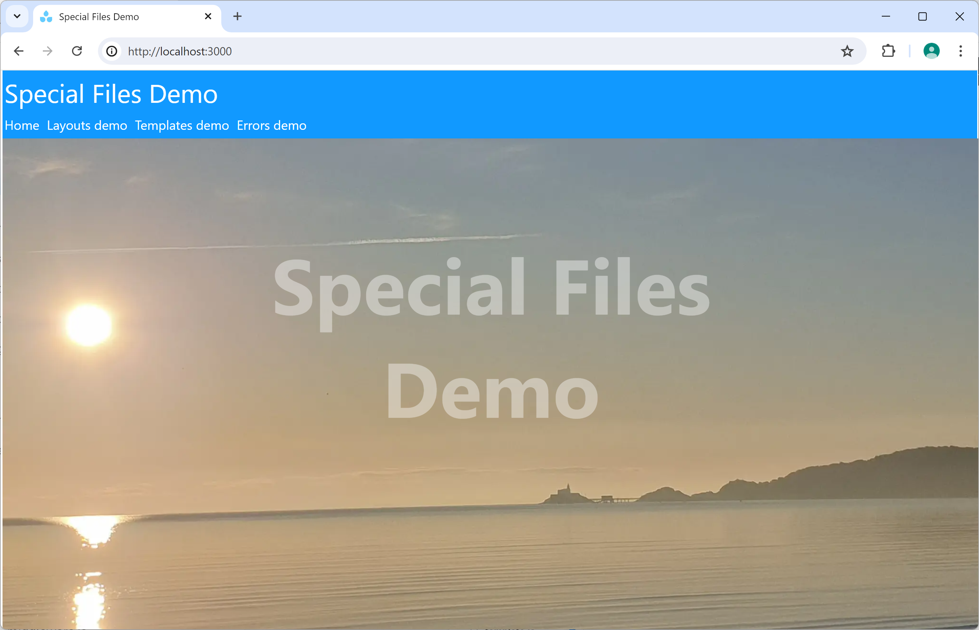
Overview
In this section we'll take a closer look at several special files in a Next.js application
See the demo app demo-special-files
Prepare and run as follows:
npm install
npm run dev

Slide 11
Layouts (1 of 2)
As you know, a layout defines a common layout for a bunch of routes
A layout is loaded when the user goes to one of its routes
The layout can maintain state
The layout's state is retained during navigation in its routes
The layout is destroyed upon navigation elsewhere

Slide 12
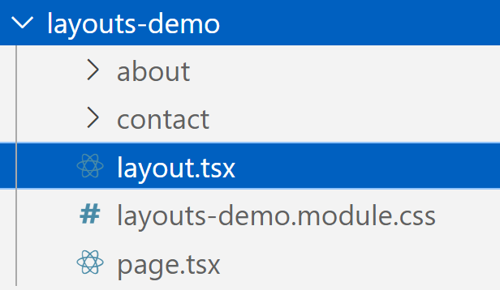
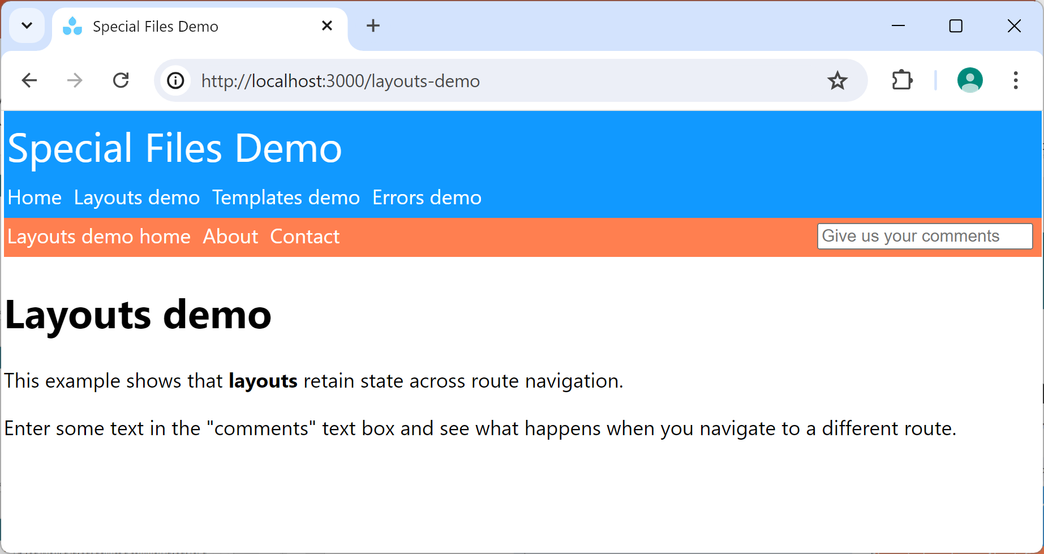
Layouts (2 of 2)
Take a look at the layouts-demo part of the demo:
See what happens when you navigate to About and Contact
Then see what the code looks like in layout.tsx

Slide 13
Template Files (1 of 2)
A template file (template.js) is similar to a layout, except it doesn't retain state across navigations
A template file:
Holds state temporarily while a user is on a particular route
Releases the state when the user moves to a different route

Slide 14
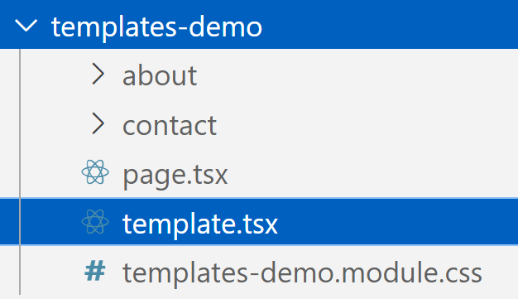
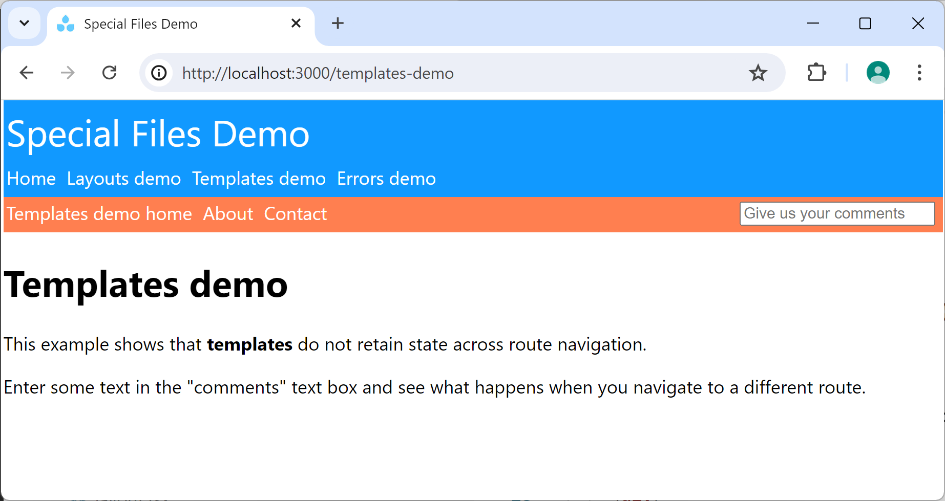
Template Files (2 of 2)
Take a look at the templates-demo part of the demo:
See what happens when you navigate to About and Contact
Then see what the code looks like in template.tsx

Slide 15
Error Files (1 of 3)
An error file (error.js) defines an error component to handle unexpected errors from components
An error component must be a client component
An error component receives an error property (an instance of the Error class), with the following properties:
message - The error message from the component
digest - A generated hash (server components only)
reset - A function you can call, to re-render component

Slide 16
Error Files (2 of 3)
Here's an example error page in the demo app:
'use client'
import { useEffect } from 'react'
export default function Error(
{error, reset}: { error: Error & {digest?: string}, reset: () => void }
) {
useEffect(() => console.error(error), [error])
return (
<div>
<h1>Error occurred 😨</h1>
<h2>Error message: {error.message}</h2>
<button onClick={reset}>Try again</button>
</div>
)
}
/app/error.tsx

Slide 17
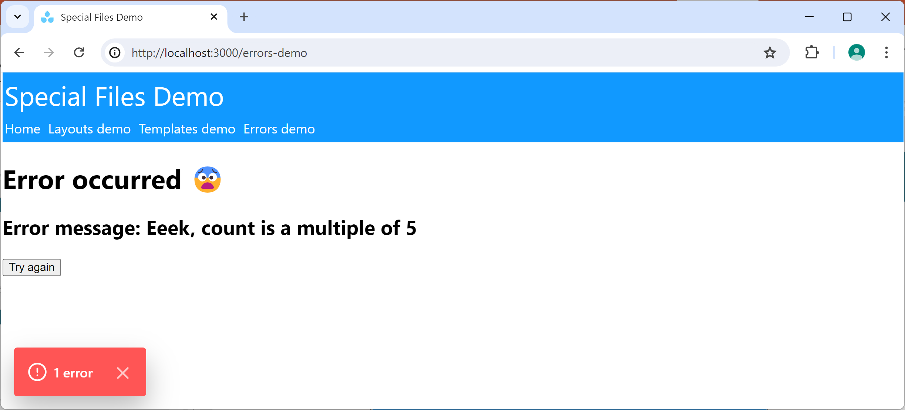
Error Files (3 of 3)
To trigger an error…
Go to the errors-demo route
Click the button a few times…
Note:
This error overlay is only displayed in "dev" mode
If you run the app in "prod" mode, it won't appear

Slide 18
Section 3: Client Component Routing Techniques
Overview
Navigating via the useRouter() hook
Navigating via the native History API

Slide 19
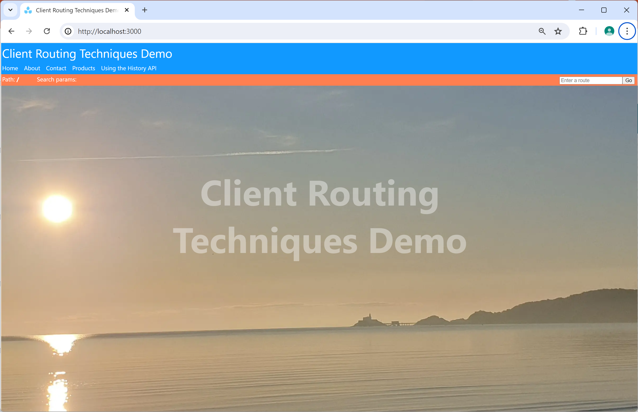
Overview
In this section we'll take a closer look at various routing techniques that are specific to client components
See the demo demo-client-routing-techniques
Prepare and run as follows:
npm install
npm run dev

Slide 20
Navigating via the useRouter() Hook (1 of 3)
Earlier in the course we showed how to use <Link> to create a physical link to achieve navigation:
It's also possible to navigate to a route programmatically via the useRouter() hook:
<Link href='some-route'>Some label for the link</Link>
'use client'
import { useRouter } from 'next/navigation'
…
export default function SomeComponent() {
const router = useRouter()
router.push('some-route')
}

Slide 21
Navigating via the useRouter() Hook (2 of 3)
You can use these functions to navigate programmatically:
router.push(href: string)
Navigate to a route (push current route to browser history)
router.replace(href: string)
Navigate to a route (replace current route in browser history)
router.refresh()
Re-render current route immediately, fetching data afresh
router.prefetch(href: string)
Prefetch a route, for faster subsequent transition
router.back()
Navigate back to previous route in browser history
router.forward()
Navigate forward to next route in browser history

Slide 22
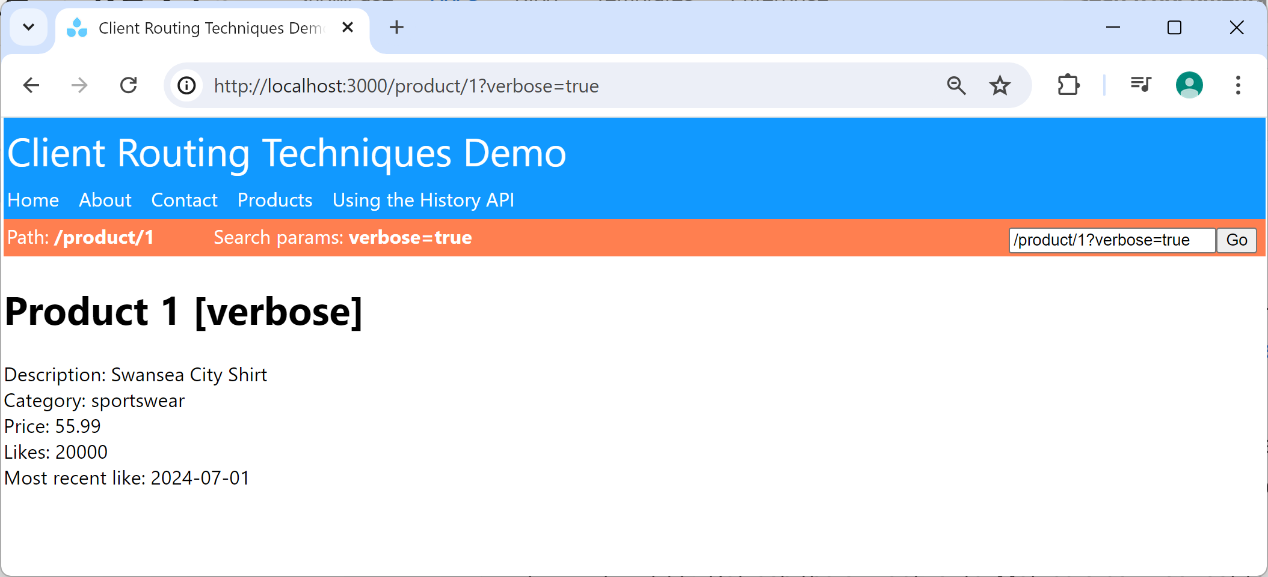
Navigating via the useRouter() Hook (3 of 3)
The demo application has a navigation bar that enables the user to navigate to any route:
For details of how it works, see
/app/_components/navbar.tsx

Slide 23
Navigating via the Native History API (1 of 2)
We've just seen how to use the useRouter() hook to navigate programmatically
An alternative approach is to use the native History API as per a regular web application:
window.history.pushState(state, unused, 'relative-or-absolute-url')
window.history.replaceState(state, unused, 'relative-or-absolute-url')
For full details about the native Browser API, see
https://developer.mozilla.org/en-US/docs/Web/API/History

Slide 24
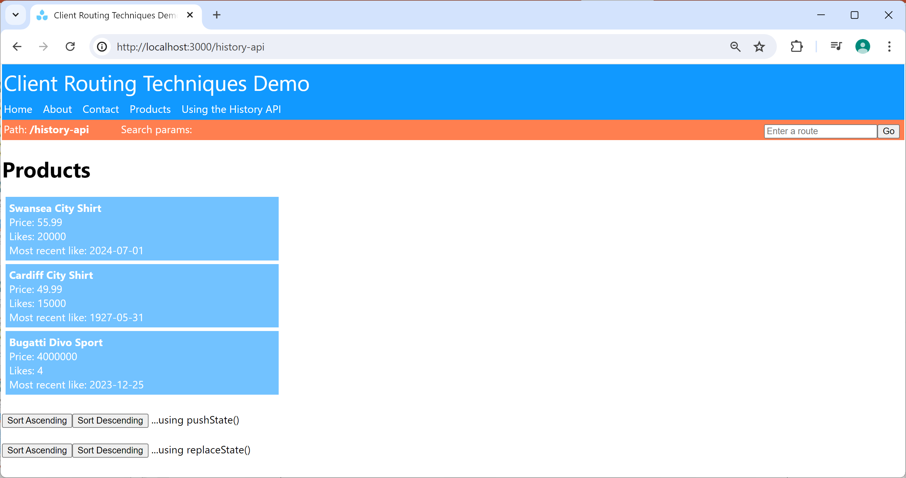
Navigating via the Native History API (2 of 2)
The demo application illustrates how to navigate via the native History API:
For details of how it works, see
/app/history_api/page.tsx

Slide 25
Summary
Overview of client components
Special files
Client component routing techniques

